Slide 1
BS EN 1090: Everything You Need to Know to Remain Compliant
Peter Sumpton – Marketing Consultant (Host)
Manochehr Salek, BSc, CEng, MIMechE - BBA Technical Assessor (Presenter)
8th December 2021

Slide 2
Webinars
Current and Future Webinars: https://www.bbacerts.co.uk/webinars/
Subscribe to the mailing list: http://eepurl.com/hfdvaX

Slide 3
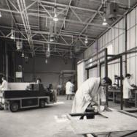
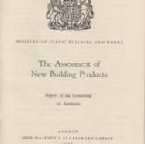
The BBA
For over 50 years, we’ve been helping the construction and manufacturing industries build confidence in the solutions designed, created and implemented throughout the entire supply chain.
The BBA develops long-term partnerships with clients and associations to enable continued growth in both the UK and Global marketplaces, while remaining reassuringly impartial.
As a for-profit organisation Limited by Guarantee, the BBA looks to reinvest in the industry as a whole for the benefit of all stakeholders.

Slide 4
What we do
Product Approval Certification
BBA Agrément Certification
Reproduction Certification
HAPAS
Testing
Audit and Inspection
Management Systems
UKCA Marking

Slide 5
To date
6,000+
72+
170+
CERTIFICATES ISSUED
COUNTRIES REPRESENTED by CLIENT BASE
BBA PEOPLE
50+
400+
8,000+
YEARS IN BUSINESS
TESTING METHODOLOGIES
ANNUAL INSPECTIONS AND ASSESSMENTS

Slide 6
What we’ll cover;
Construction Products Regulations
Who enforces compliance?
Consequences of non-compliance
What is the designated 1090 standard (BS EN 1090)?
What products are covered
Who must comply
The route to compliance
Role of Notified Bodies such as BBA
Q&A

Slide 7
Understanding the Regulations
The Construction Products Regulations 2013, Construction Products (Amendment etc) (EU Exit) Regulations 2019 and The Construction Products (Amendment etc.) (EU Exit) Regulations 2020
The Construction Products Regulations 2013 and it’s EU Exit amendments specifies that:
It is against the law to supply a construction product that is covered by a harmonised European standard (hEN) or a European Technical Assessment (ETA- UKTA) without a Declaration of Performance (DoP) and a CE (UKCA from 1st of January 2023) mark.
The compliance with the requirements of EN standards, now called designated standards, or ETA-UKTA is therefore a legal requirement.
A person guilty of an offence under these regulations shall be liable on summary conviction to imprisonment for a term not exceeding three months or to a fine not exceeding level 5 on the standard scale or to both.

Slide 8
Who enforces compliance?
Trading Standard authorities have the duty to ensure compliance with these regulations via surveillance visits, both announced and unannounced if they suspect failure to comply with any requirements.
Under these regulations:
They have the power to inspect any construction products and enter any related premises other than a place of residence.
Examine any procedure connected to the production of the construction product
Examine any records relating to the business
Seize and detain products and even open or break open containers to get access to products or records

Slide 9
Consequences of non-compliance
Breaking the law, facing a fine and or prison term in extreme cases
Non-compliance with building regulations and local authorities
Potential issues with building insurance requirements
Exclusion from many construction projects
Loss of business / business disruptions

Slide 10
What is the designated 1090 standard (BS EN 1090)?
BS EN 1090 is the harmonised European Norm / standard (hEN) that covers the steel and aluminium structures and will be referred to as the designated standard since UK has left the EU.
Part 1 of this standard (BS EN 1090-1) relates to Requirements for conformity assessment of structural components.
Part 2 of this standard (BS EN 1090-2) relates to Execution of steel and aluminium structures, technical requirements for steel structures.
Part 3 of this standard (BS EN 1090-3) relates to Execution of steel and aluminium structures, technical requirements for aluminium structures.
Compliance with BS EN 1090 is a mandatory requirement and legal obligation as per Construction Products Regulations (CPR).

Slide 11
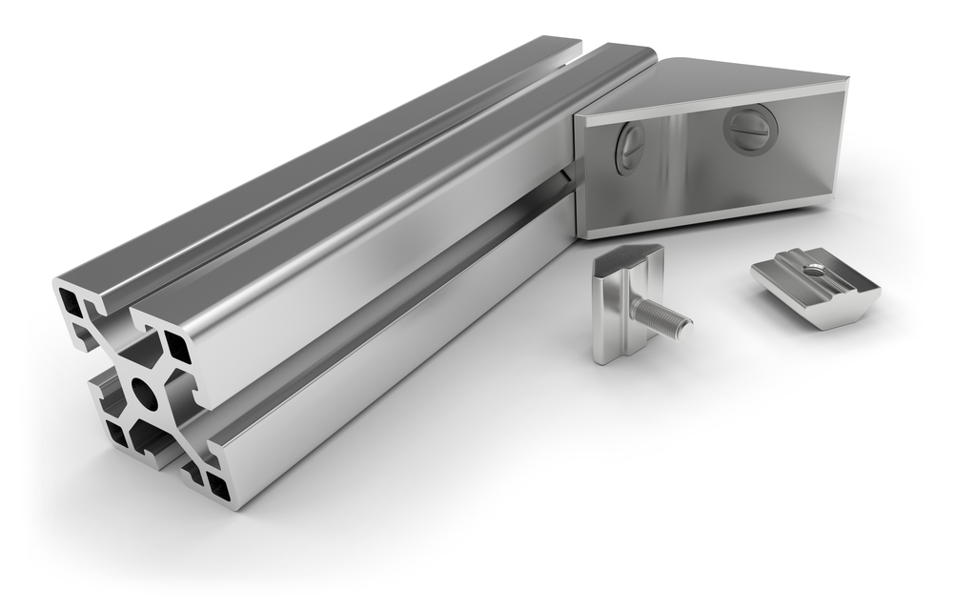
What products are covered by this standard?
Basically, any structural kit or component made from steel or aluminium which is load bearing and permanent, for example and not limited to:
Structural frames for use in buildings including:
Agricultural sheds
Portal frames for warehouse, industrial sheds etc
Frames for buildings (including dwellings; offices, commercial, hospitals, education, recreational buildings etc)
Sheds
Staircases, balconies, canopies, structural fences.
Fire escapes, ladders, catwalks, walkways, including open mesh flooring, ramps, guardrails, handrails and balustrades
What is not covered, for example and not limited to:
Any component covered by other harmonised norms or ETAs other than EN 1090
Non-structural architectural components
Temporary works
Off shore structures

Slide 12
Who must comply with CPR and 1090 standard?
The person, or the organisation which manufactures and supplies / places the product on the market

Slide 13
The Route to Compliance
Manufacturers must secure a Factory Production Control (FPC) Certificate, as per requirement of 1090, issued by a Notified Body
and
Draw up a Declaration of Performance which in effect CE (UKCA from 1st of January 2023) marks their product.

Slide 14
Role of Notified Bodies such as BBA
The Notified Body (NB), like BBA, will carry out:
Initial assessment of the manufacturers documented FPC and the manufacturing plant.
On successful initial assessment, the NB will then issue an FPC certificate.
Continuous surveillance, assessment and approval of the FPC.
BBA has significant experience in assessing and issuing of FPC Certificates meeting the requirements of EN 1090.

Slide 15
EN 1090 Key Points
This standard introduces the concept of execution class (EXC) as a classified set of requirements specified for the execution of the works as a whole, of an individual component, or of a detail of a component.
It is a design decision for the specifier to select the execution class required.
There are four Execution Classes - 1 is the least onerous and 4 is the most onerous - to cover construction applications from an agricultural shed to a stadium or long span bridge subject to fatigue loading.
These classes are referred to throughout BS EN 1090 to differentiate between audited levels of quality, testing and qualifications of the manufacturer
The recommended procedure for determining Execution Class is given in Eurocode 3: Design of steel structures, EN1993-1-1:2005/A1:2014 Annex c. It is linked to Consequence Class (risk to human life, economics and the environment from structural failure or collapse),
Production Category (complexity of fabrication) and Service Category (actions and stress to be imposed on the structure).
The majority of the manufacturers require FPC Certificate to EXC2 allowing them to manufacture up to medium sized commercial and residential structures.
BBA has issued many EN 1090 FPC Certificates for all 4 Execution classes.

Slide 16
EN 1090 Key Points (continued…)
A Welding Quality Management System (WQMS) is required that is in accordance with relevant part of EN ISO 3834, depending on EXC class.
For EXC2 and above, the manufacturer must either employ, or have access to, a Responsible Welding Coordinator (RWC) to control their WQMS meeting the requirements of BS EN ISO 14731:2006 Welding Coordination.
The manufacturer must draw up a Weld Procedure Specification (WPS) which details the weld type and all relevant parameters such as preparation, pre-heat, voltage, Amps, welding wire and speed, shielding gas and flow rate, material grade and thicknesses, weld dimensions etc.
A specific weld sample, produced in line with the company’s WPS by the company welder (s), must be examined in detail by an accredited lab as per requirement of the relevant standards, BS EN ISO 15614‑1:2017+A1:2019.
The successful results of examination of the weld samples, the Weld Procedure Qualification Records (WPQR) and Welder’s Test Certificate are issued, and these are examined during the assessment by the NB.

Slide 17
Other key related areas assessed by the NB
Review of contract requirements
Technical review of contracts
Sub-contracting
Equipment
Premises
Storage and handling welding consumables
Storage of parent materials
Post-weld heat treatment
Inspection and testing before welding
Inspection and testing during welding
Inspection and testing after welding
Non-conformance and corrective actions
Calibration and validation of measuring, inspection, and testing equipment
Identification and traceability
Quality records

Slide 18
Q&A

